Slide 1

PowerOn Midwest 765kV & 345kV Projects
Stacy Kotch Egstad| Utility Routing & Siting Coordinator
Energy Infrastructure Permitting with the Public Utilities Commission

Slide 2
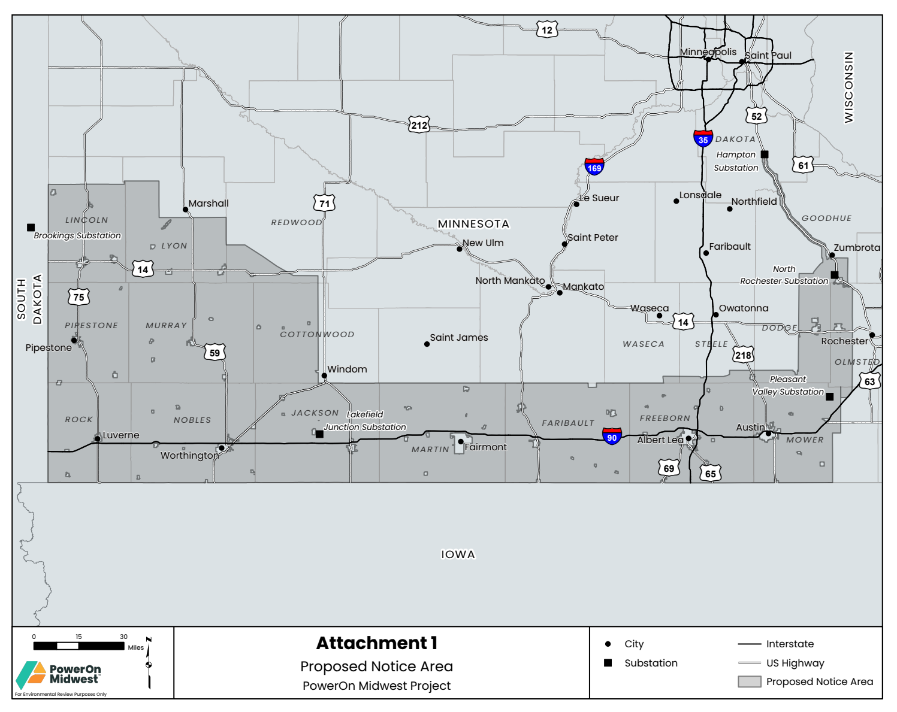
PowerOn Midwest Project Components
As a part of the MISO LRTP Tranche 2.1 projects, establish a new 765 kV “backbone” across the Midwest.
Applicants intend to file an application for a Certificate of Need* (CN Application) for the Project with the PUC no later than February 6, 2026.
The CN Application will include the Minnesota portions of LRTP Nos. 22, 23, 24, and 25.
Applicants will submit separate route permit applications for these projects, beginning no earlier than late 2026.
*In Minnesota, certain large electric generating facilities and large high-voltage transmission lines are required by law to obtain a certificate of need in addition to any necessary site or route permits. A certificate of need is an approval from the Minnesota Public Utilities Commission that confirms the demonstrated need for a large electric generating facility or high-voltage transmission line.

Slide 3
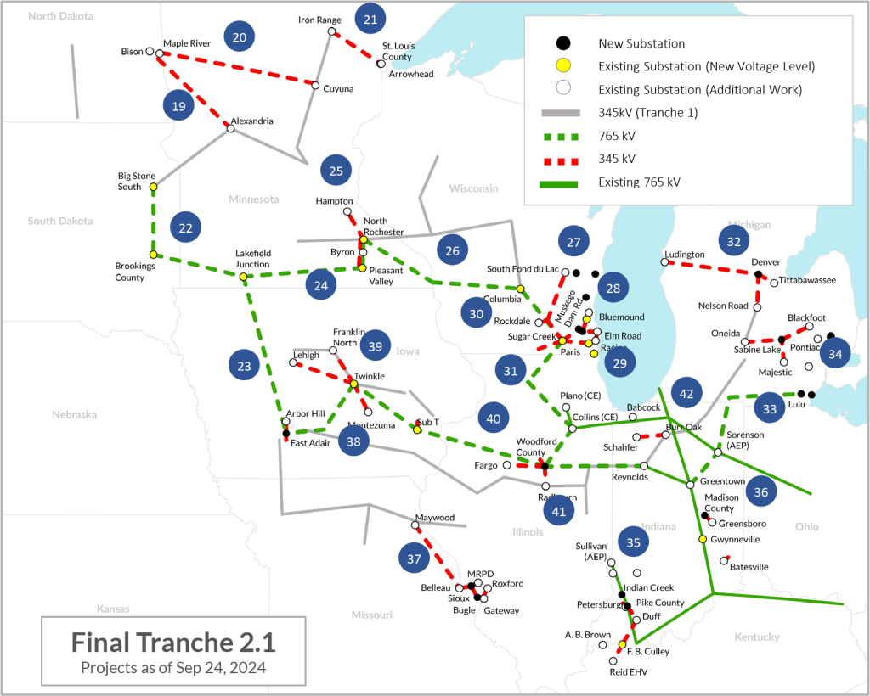
MN Projects in MISO LRTP Tranche 2.1
Bison – Alex 345kV 2nd Circuit (LRTP #19)
Maple River – Cuyuna 345kV (LRTP #20)
Iron Range – St. Louis Co – Arrowhead 345kV (LRTP #21)
Brookings – Lakefield 765kV (LRTP #22)
  SD/MN border and the Lakefield Junction Substation in Jackson County
Lakefield Jct – East Adair 765kV (LRTP #23)
  Lakefield Junction Substation and the MN/Iowa border
Lakefield Jct – Pleasant Valley 765kV (LRTP #24)
  Lakefield Junction Substation and the Pleasant Valley Substation in Mower County
Pleasant Valley – North Roch (LRTP #25)
  Pleasant Valley Substation and the North Rochester Substation in Goodhue County
North Rochester – Columbia 765kV (LRTP #26)
  Not a part of this set of Projects

Slide 4
MN Projects in MISO LRTP Tranche 2.1
• A new 345 kV transmission circuit from the Pleasant Valley Substation to the North Rochester Substation. The existing 345 kV single-circuit structures are proposed to be removed and replaced with new double-circuit capable 345 kV structures
• A new, second 345 kV transmission circuit between the North Rochester substation to the Hampton Substation, to be strung on existing double-circuit capable 345 kV structures (LRTP #25 too?)
Expansions / improvements at the following existing substations:
  • Lakefield Junction Substation in Jackson County
  • Pleasant Valley Substation in Mower County
  • North Rochester Substation in Goodhue County
  • Hampton Substation in Dakota County

Slide 5
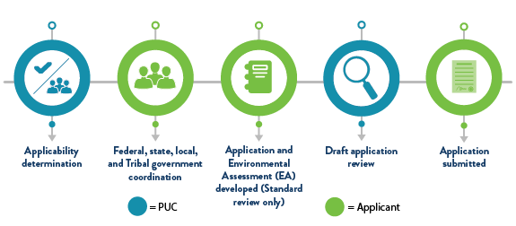
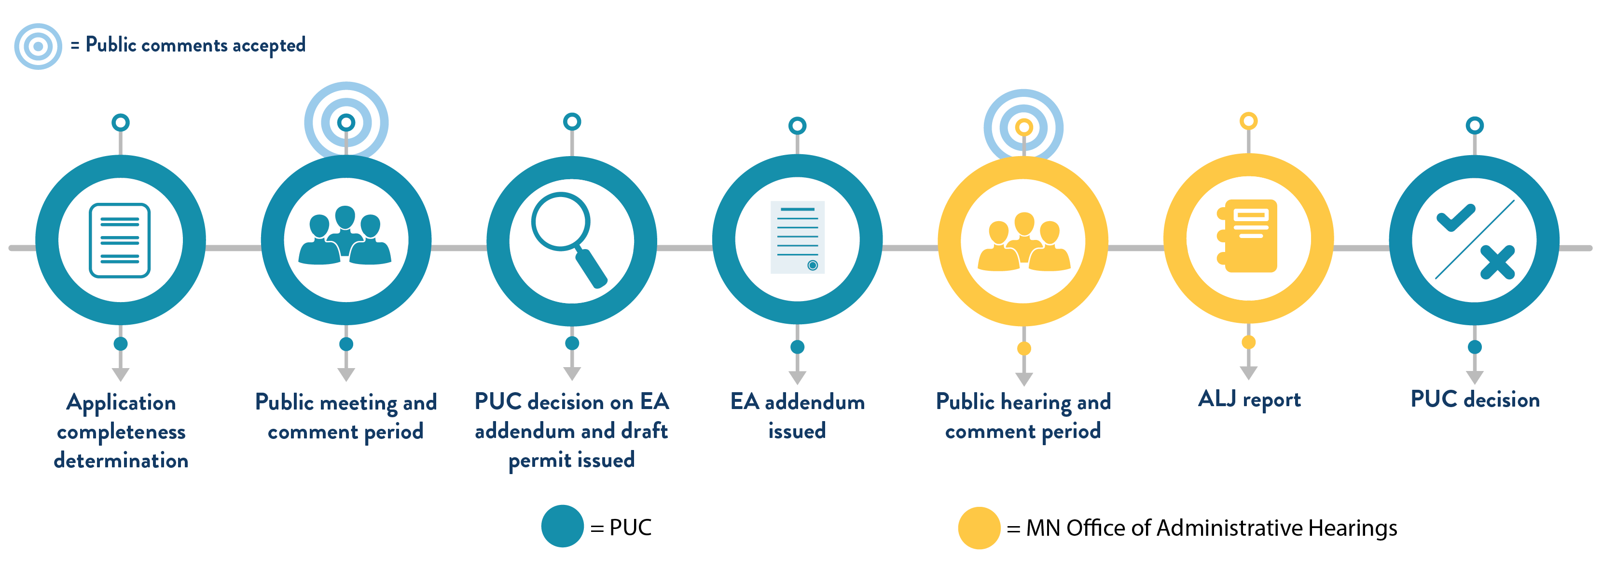
The PUC Processes
Preapplication Process
Standard Review Process
Major Review Process

Slide 6
The PUC Processes
PUC’s LEI Draft Guidance states:
Transmission Line Design: Discuss the following design considerations in the text and illustrate them on the accompanying maps:
Requested route width: The application should describe the route width the application is requesting, highlighting areas where the applicant seeks an expanded route width (e.g., around substations, near road intersections, near natural resource areas). Maps should illustrate the requested route width.
Required ROW width: The application should discuss the ROW required for the transmission line, indicating where the proposed route shares or parallels existing road or transmission ROW. The applicant must demonstrate that it has the ability to control the transmission line ROW in such a manner as to ensure its safe operation, particularly with respect to the National Electric Safety Code and applicable National American Electric Reliability Corporation standards. Maps should illustrate the required ROW.
ROW Sharing and Paralleling: The PUC must consider, when appropriate, routes that would use or parallel existing railroad and highway ROW.120 When applicable, the PUC must make a specific finding that the PUC considered locating a transmission route on an existing route and using parallel existing highway right-of-way. If an existing transmission route or parallel existing ROW is not used, the PUC must state the reasons. 121 Discuss whether the applicant considered locating the facility along an existing transmission line or parallel to or within existing highway ROW.
Anticipated Alignment: The application should discuss generally the anticipated alignment and illustrate the alignment on application maps.

Slide 7
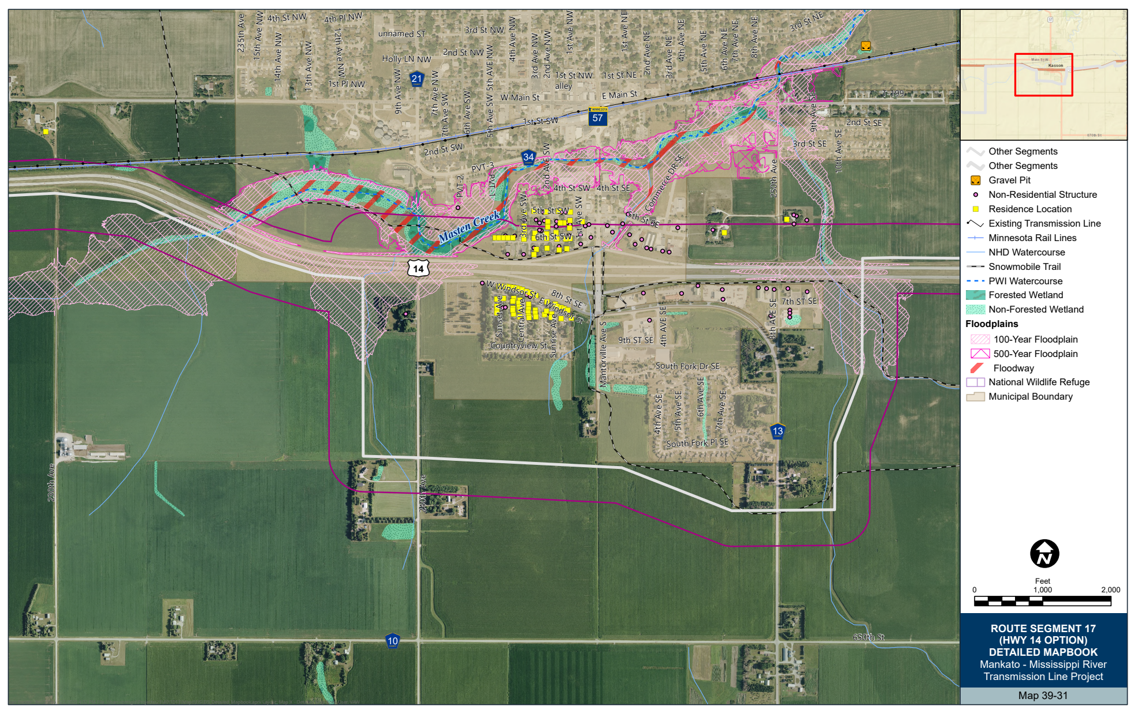
The PUC Processes

Slide 8
Deeper Dive…How is MnDOT Involved?
Utility Early Notification Memo (ENM) and Supplemental Checklist
*Preferred engagement 3 months prior to RPA/SPA*
  Populated by project proposers
  Specifically identifies project areas impacting MnDOT resources
  Wide range of impact information
    Scope of work/project timeline
    GIS/Non-GIS Mapping/Typicals
    Other State/Federal Agency coordination documents to-date
Reviewed by:
  ALL Environmental Stewardship (OES)
  District Permit/Planning
  Design Support
  Safety and Operations
  Rail
  Aeronautics
  Safety Rest Area
  Historic Roadside Properties
  Living Snow Fences/Blowing/Snow Control
  Statewide Radio Communications (wind projects only)
  Regional Transportation Management Center (RTMC)/ITS/TMS
30-day review timeline

Slide 9
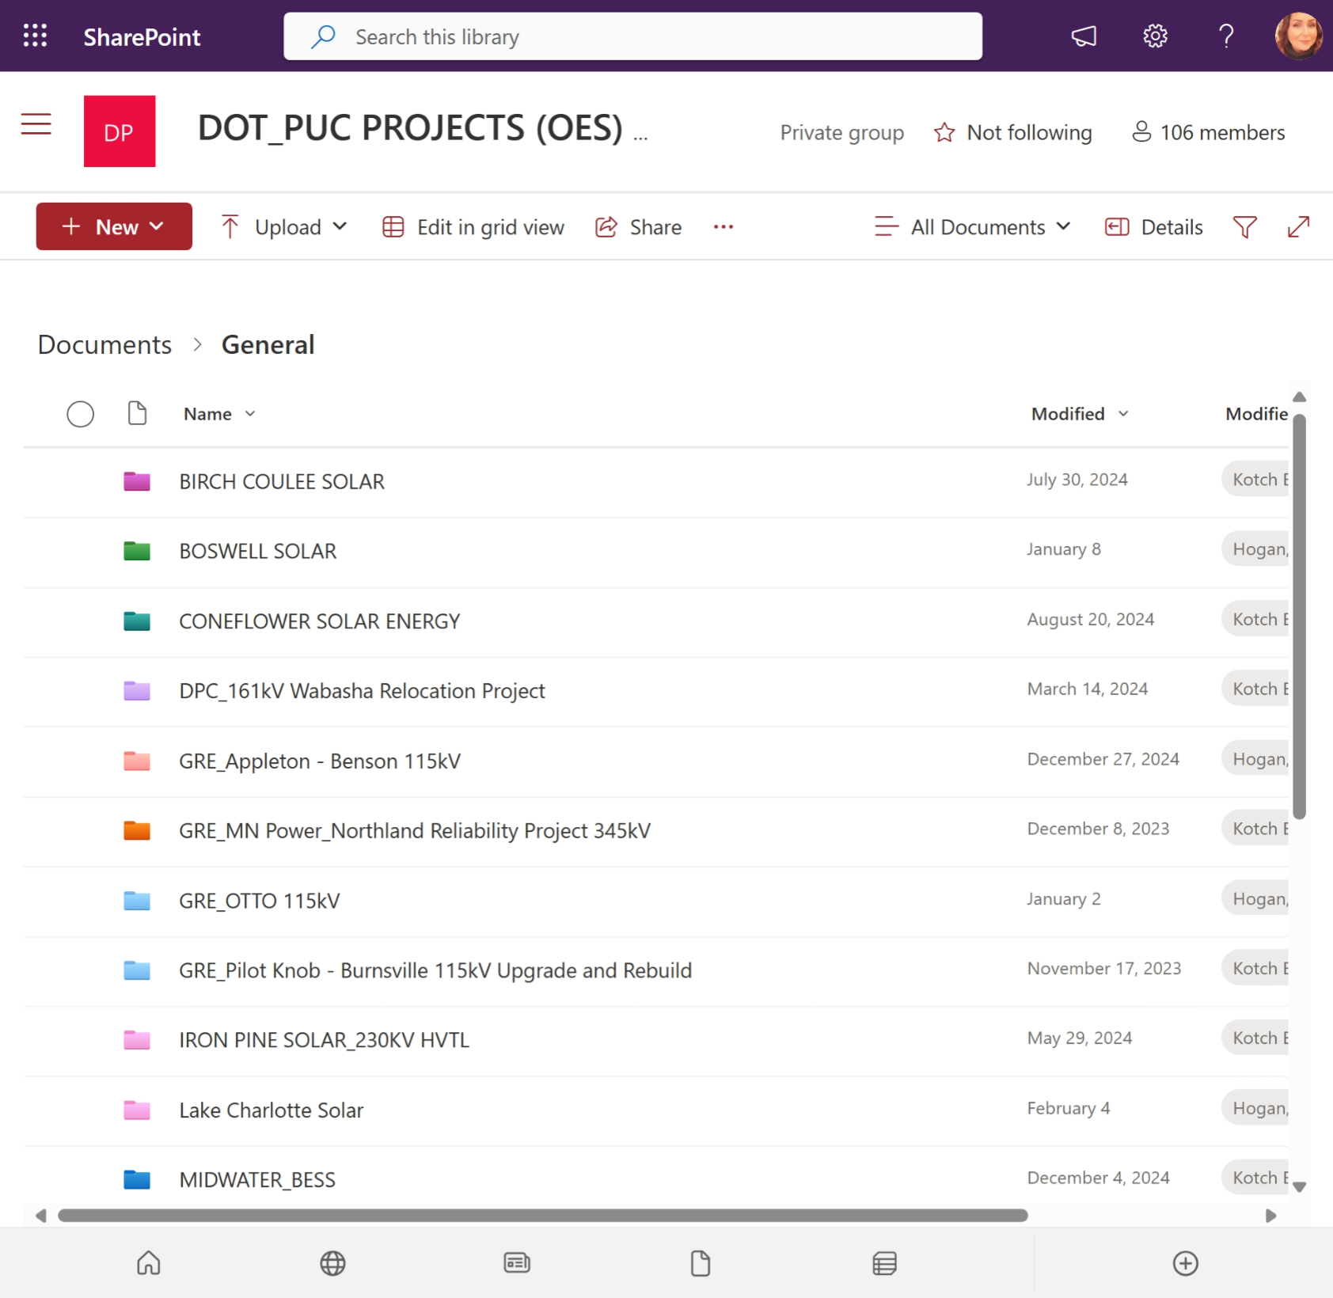
Deeper Dive…How is MnDOT Involved?
ENM/Project reviews in SharePoint/Teams
  ENM Main Files
    Populated ENM
    Supplemental Checklist
  Mapping/Shapefiles
  Supplemental Information
    Relevant PUC docket submittals
    Project Fact Sheets
    Meeting Notes
    Applicant’s Project Website
    Commenting Spreadsheet
    Autosave enabled
    Simultaneously accessible
One-stop review shop
365

Slide 10
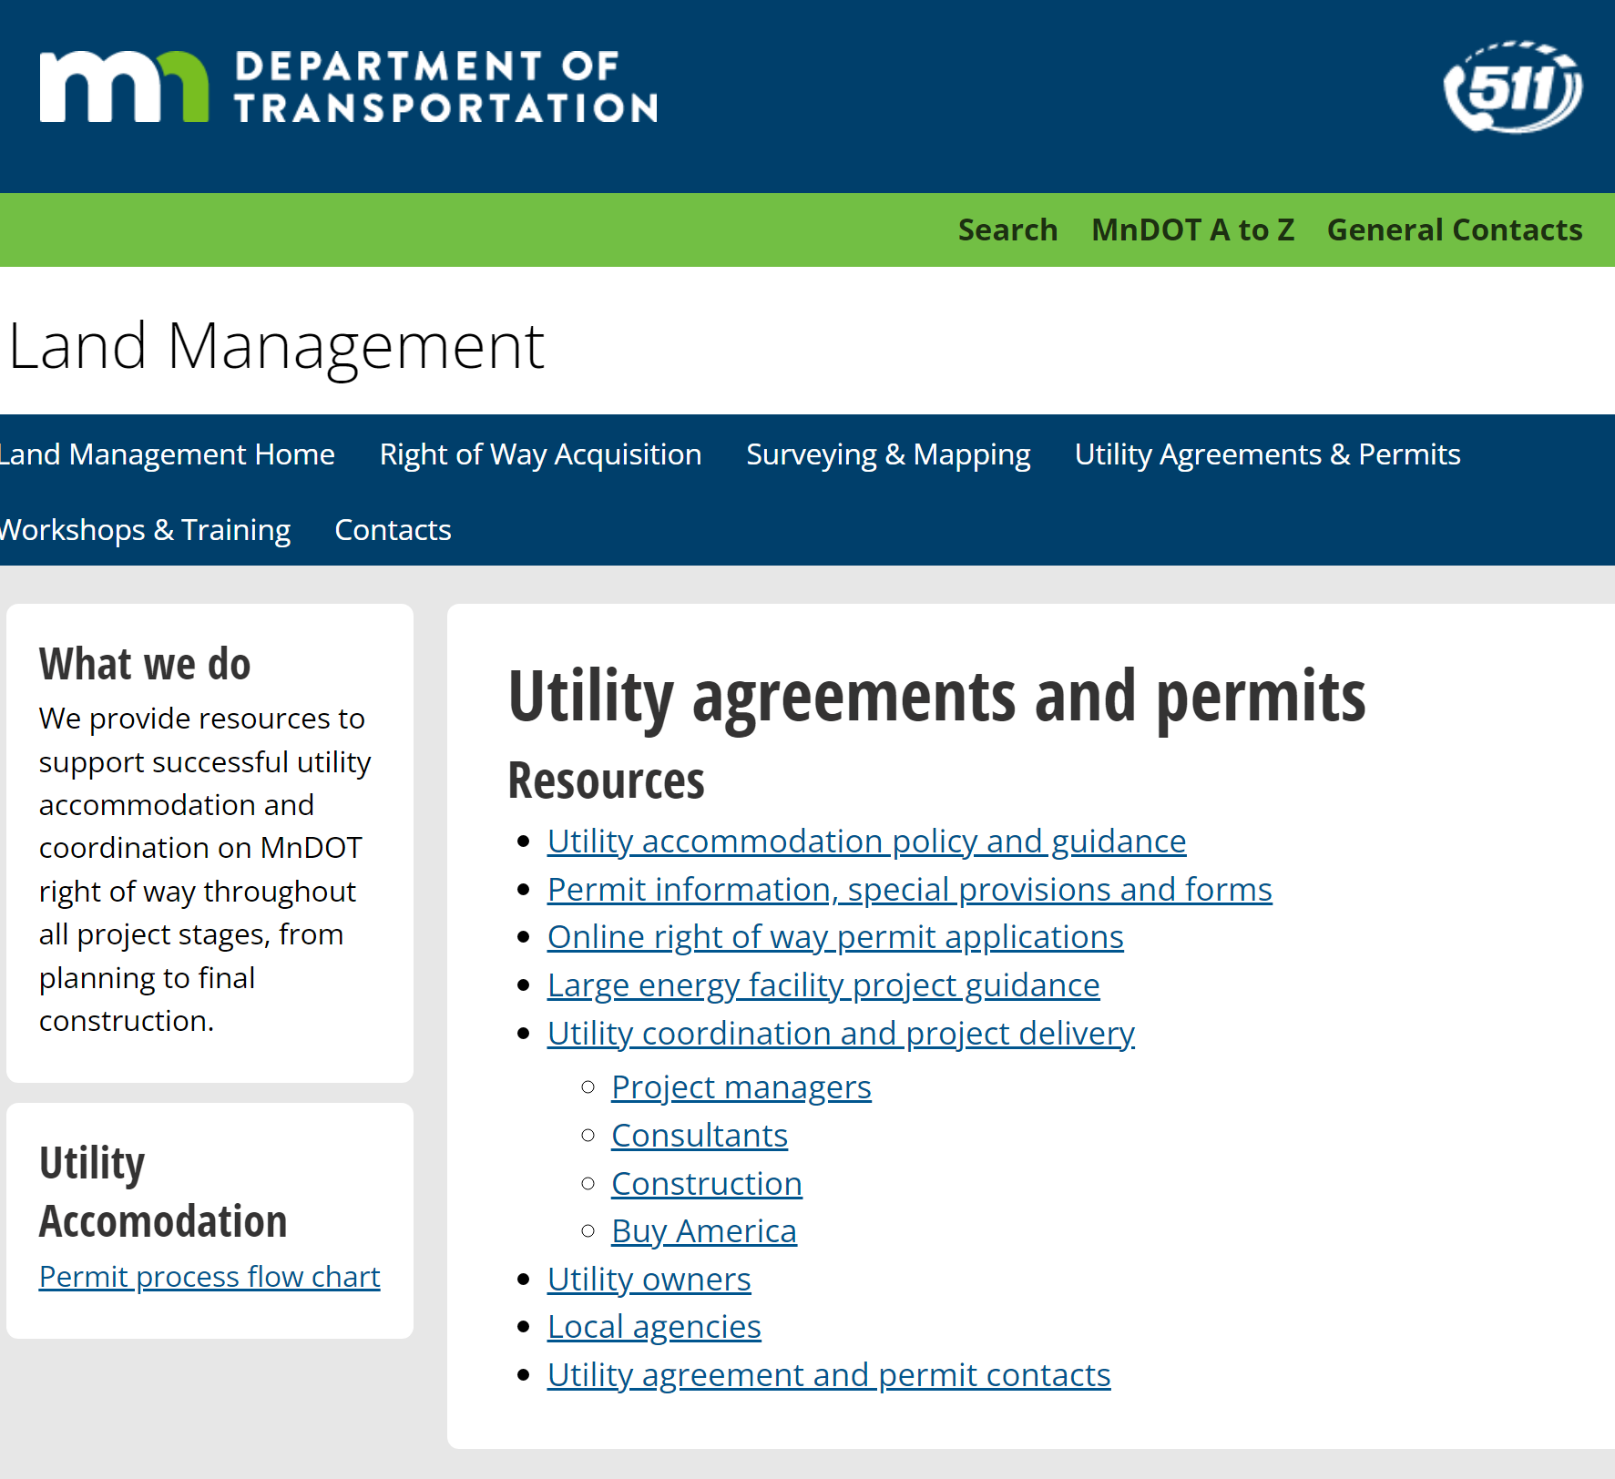
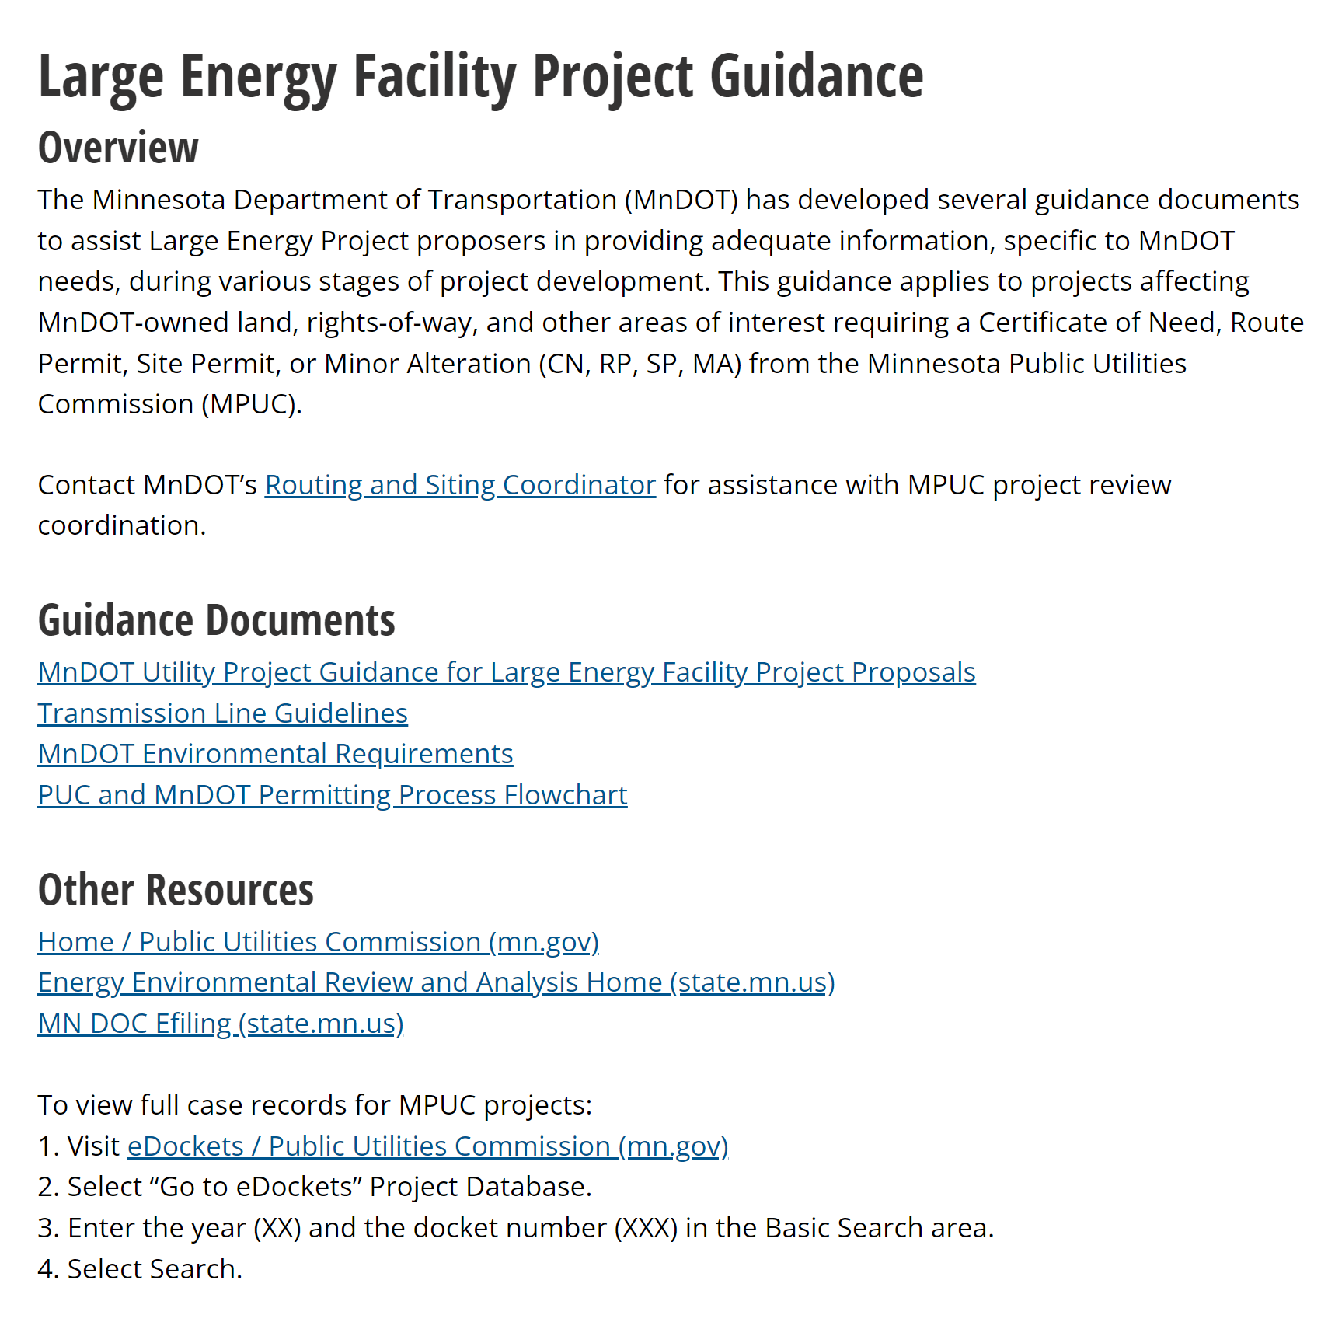
Deeper Dive…How is MnDOT Involved?

Slide 11
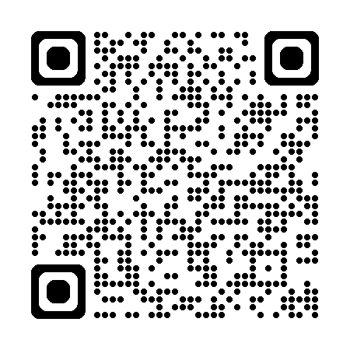
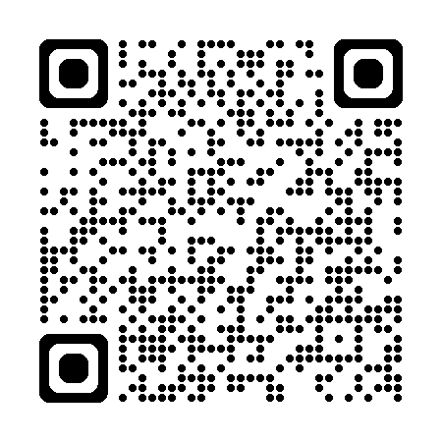
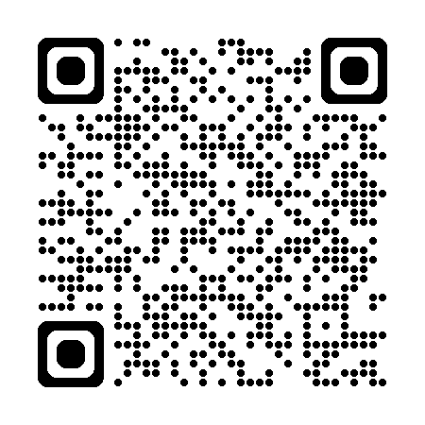
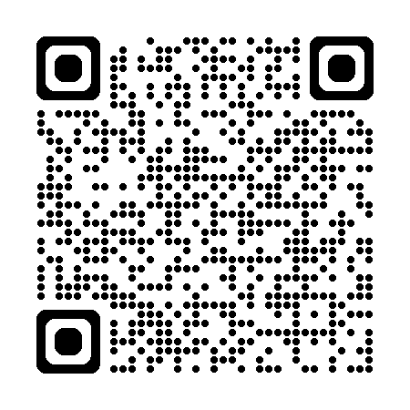
Resources
EIP Projects DOT EIP Page UAP Page MISO LRTP

Slide 12
Thank You!
Stacy Kotch Egstad
stacy.kotch@state.mn.us
651-358-0786

