Slide 1

Impacts of High-Volume Water Users on Regional Water Planning
Jen Kostrzewski, Assistant Manager, Water Resources Policy and Planning, Environmental Services
Environmental Quality Board
November 19, 2025

Slide 2
Presentation outline
Background
Planning process
Key areas of concern
Conclusions

Slide 3

Location, location, location
What makes an ‘ideal’ location for high-volume water users?
Abundant water
Capacity on the electrical grid
Fiber optic cables and latency
Transportation and distribution corridors
Land availability
Financial incentives
Skilled workforce

Slide 4
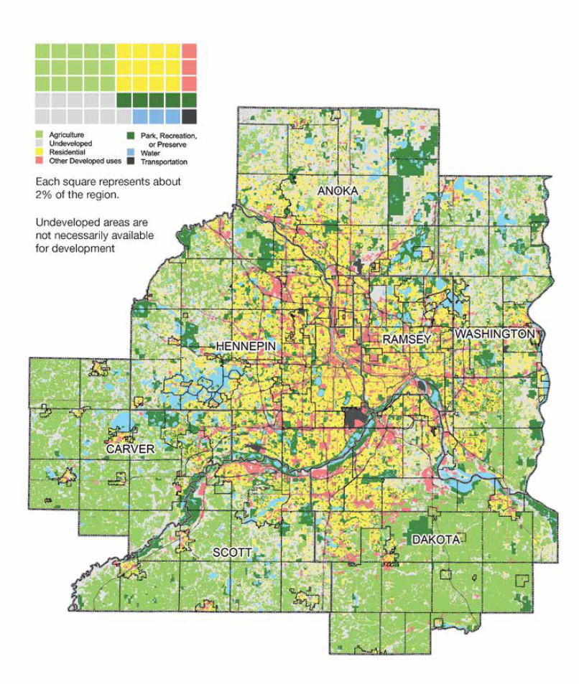
What about the seven-county metro region?
Abundant water?
  Yes, there is a perception of abundance
Capacity on the electrical grid?
  Yes, there is a long-range plan to build up transmission lines across the Midwest
Fiber optic cables and latency?
  Yes, The Minnesota Internet Exchange connects the region to Chicago, Denver, Des Moines and others.
Transportation and distribution corridors?
  Yes, the region has a robust transportation system.
Land availability?
  Yes.
Financial incentives?
  Yes, MN DEED and Greater MSP are recruiting industry to the state and region.
Skilled workforce?
  Yes, we have a strong, skilled workforce.
Cold climate?
  Yes, this helps offset cooling/electrical needs.

Slide 5






How do we plan for this?
Economic Development teams help site the project
Municipalities are approached to evaluate land use, power use, water use
Agreements are reached and the project goes public
Concerns raised by citizens, legislators, water managers
Site Design (Will Serve Notice)
Environmental Review (AUAR / EAW / EIS)
Comprehensive Plan / Plan Amendment
Notes:
Our current long range and local plans do not contemplate these types of large volume water users as part of a typical land use

Slide 6
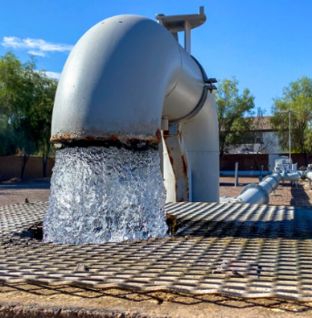
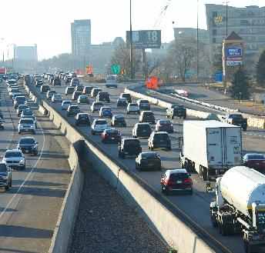
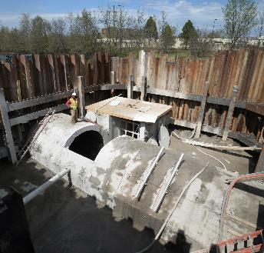
Site design/will serve
Developers need infrastructure
Greater MSP / Mn DEED / Technical Representatives
Requests for wastewater service
The Met Council does not sign non-disclosure agreements
Met Council evaluates for wastewater system capacity and potential treatment process impacts from a wastewater utility perspective
Through this process ES staff have been engaging with developers' engineers to better understand the developments and to evaluate our ability to serve

Slide 7
Comprehensive Plan Process
Long Range Planning for Regional Needs
Cities, townships and counties in the seven-county area prepare comprehensive plans as required by the Metropolitan Land Planning Act.
Responsibilities of Met Council staff:
Plan for regional development in a twenty-five-year horizon every ten years
Coordinate review of local comprehensive land use plans and environmental documents
Provide professional planning and technical assistance
Assist cities with implementing local plans and programs, and help in resolving issues
Conformance
with regional system plans
Compatibility
with the plans of adjacent and affected jurisdictions
Consistency
with Council policies
Notes:
If a local government modifies any part of its adopted comprehensive plan, it must submit a comprehensive plan amendment to the Council for review.
Amendments may be needed for:
Neighborhood or small area planning updates
Land use changes for a proposed development
Adjustments to forecasts or the Metropolitan Urban Service Area (MUSA)
Policy or land use category revisions
Routine updates, such as public facilities changes
System statement updates impacting the community

Slide 8

Key areas of concern
Planning without enough information raises areas of concern:
Environmental impacts on nearby water bodies
Risks of municipal permits being used for industrial needs
Industrial use vs. long-term population needs
Cumulative impacts on wastewater and local water supplies
Regional wastewater impacts
Wastewater discharge permitting
Plan amendment decisions prior to DNR permitting timing
Regional growth management and capital investment impacts

Slide 9
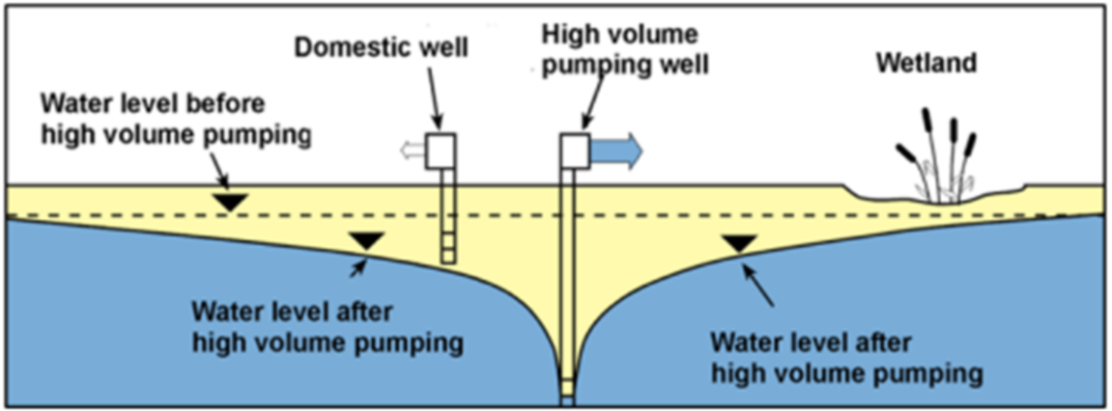
Impacts on nearby water bodies
High-volume pumping can affect water quantity and quality
Drawdown cones can lower water levels to inhibit access to shallower wells (well interference).
Geogenic pollutants (e.g. arsenic, manganese) can be mobilized into private wells.
Groundwater-dependent surface waters (e.g. trout streams, fens, wetlands) can lose connection to groundwater.
Increased impervious surfaces (roofs, parking lots) can increase pollution in run-off.

Slide 10

Water supply allocation
Industry obtains a water supply allocation permit
If the industry applies for its own allocation permit, it must work with the DNR. The Water Appropriation Permit Program exists to balance competing management objectives that include both development and protection of Minnesota's water resources.
A water use permit from the DNR is required for all users withdrawing more than 10,000 gallons of water per day or 1 million gallons per year.
Industry connects to municipal supply system
The industry could alternatively connect with the municipal water supply system if there’s adequate capacity. This could increase the municipality’s revenue as the high-volume water user would become a new customer.
Notes:
A high water user connected to a municipal water supply system represents a capacity trade-off between that used to accommodate growth (population) and industrial growth (traditionally jobs). However, data centers is not require a large employment base to operate relative to the size of the facility. Also large water users utilizing municipal water supplies often times require communities to seek additional water appropriation permits for additional wells/supply from the DNR sooner that anticipated.

Slide 11
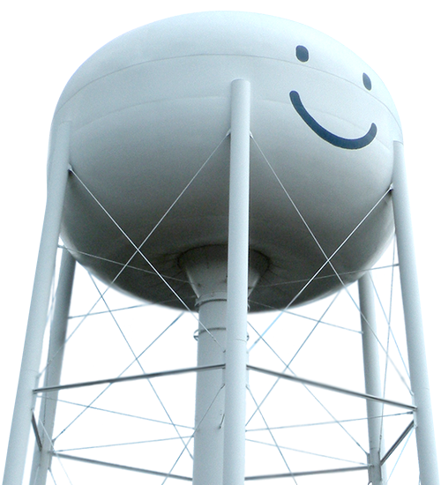
Municipal water appropriation permit
Trade-offs to consider
If the local water supplier connects the high-volume water user to their system, there are advantages and potential risks.
Advantages
Risks
Additional revenue source
Greater financial stability
Greater ability to enhance their systems
May reduce the risk of well interference for municipal system
Additional infrastructure (wells, pumps, pipes).
Could be liable to repair any damages to affected neighboring wells.
Would not be able to limit industrial demand during drought restrictions.
May limit ability to grow without additional water allocations.

Slide 12


Industrial use vs. future population growth
Local trade-off must be considered
Council is directed by state law to develop forecasts of when, where, and how much population, household, and job growth the seven-county region and local jurisdictions can expect over a 30-year horizon. These long-range forecasts provide a shared foundation for coordinated comprehensive planning and capital investment.
The population forecasts help to determine the water demand for local water suppliers over the next 30-years.
Met Council and local governments cannot assume that the DNR, as the regulating agency, will appropriate additional water supplies.
Water conservation and efficiency actions may offset the high-volume water user ’s water demand, but many times, the offset is not enough.
This may result in a trade-off of future local population growth for industrial use.
Notes:
Last bullet good. Touched on this in earlier notes comment.

Slide 13

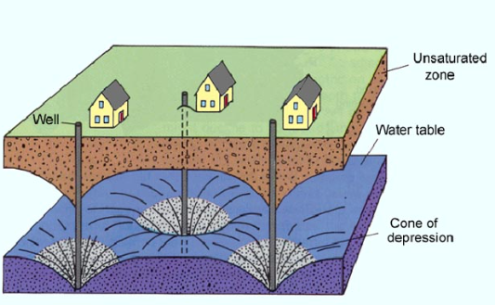
Cumulative impacts on water systems
Co-location of high-volume water users may magnify impacts
One high-volume water user development on its own may have minor impacts, but this is multiplied by hosting many in one area
Dakota County has experienced the majority of high-volume water user sitings in the metro
These high-volume water users could draw from the same aquifer and potentially discharge to the same Water Resource Recover Facility

Slide 14
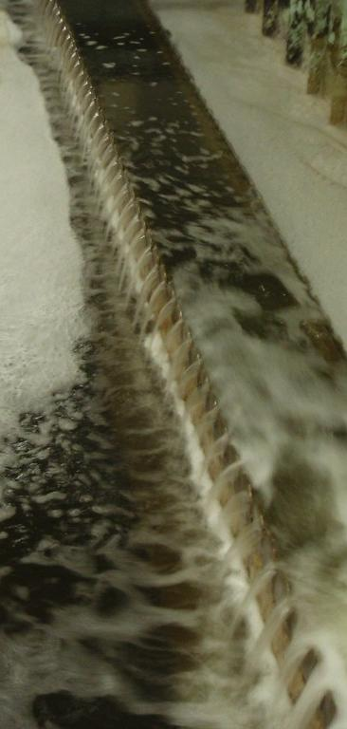
Regional wastewater concerns
Increased wastewater volume
If the high-volume water user is connected to the Regional Wastewater System, it could discharge large volumes of water into our conveyance system.
May impact available capacity for upstream and downstream communities, or result in expensive system improvements.
The cumulative effects of multiple high-volume water users will exacerbate the capacity limitations.
Water quality
The discharged cooling water does not carry as many solids as typical wastewater, is high is dissolved minerals, and is high in temperature.
These characteristics could pose difficulty to our biological wastewater treatment processes and to our effluent permitting.
Notes:
Environmental Services staff review high volume water use developments from the perspective of the regional wastewater system and potential impacts to the system and its users.
Impacts to the system could occur if the system does not have capacity to handle large volumes of wastewater. The regional system was designed with capacity to handle typically-encountered wastewater generation from urban and suburban areas. The addition of a singular large-volume wastewater discharger could push the system beyond it's capacity or take capacity away from other uses such as forecasted community growth.
Similar to the concerns from our water planning group, we are concerned about cumulative effects of multiple large volume wastewater dischargers as well. Our priority from a wastewater system standpoint is that capacity is reserved to meet the needs identified in cities' approved comprehensive plans and in our long-term system plan.
The water quality – or chemical make-up of the wastewater can also be a concern for our treatment processes. This is typically reviewed during our industrial permitting process.

Slide 15

Wastewater discharge permitting
Pollution prevention
To achieve efficient and effective use of the Metropolitan Council’s facilities, the Metropolitan Council regulates wastewater discharges into public sewers.
Met Council also enforces national and state pretreatment standards.
Example regulated waste products
Lead
Chromium
PH
Temperature
Grease
Flammable and explosive liquids
Notes:
Environmental Services' Industrial Waste and Pollution Prevention group manages a industrial discharge permit program.
Large volume water users typically have industrial wastewater discharges to the regional wastewater system, and are regulated by this permitting process to ensure they will not cause harm to our treatment systems or operations, and that they are in compliance with federal and state standards.
Some examples of regulated waste products are listed here, such as metals like lead, acidic solutions that affect the pH of the wastewater, grease, or hazardous materials.
Wastewater planning is currently working with our Industrial Waste group and others in ES to understand risks related to data centers in particular. We have hired an engineering firm to look at different scenarios and volumes of cooling water discharge. Some of the potential risks include dilution of wastewater with water that has little organics, biocides that are used in the industrial heat exchangers, and high levels of chloride or sulfate that could pose a permitting problem for our wastewater effluent.

Slide 16

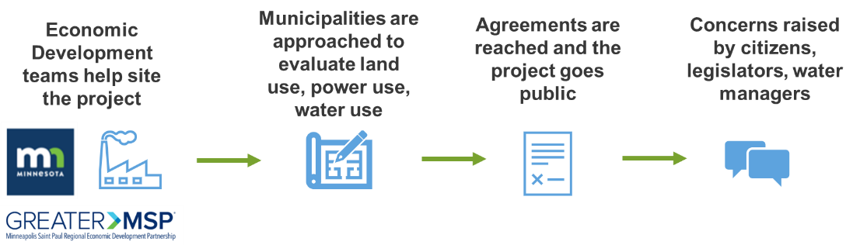
Plan review timing
Reviews are requested before full development plan is set
Environmental Review (especially the AUAR) does not specifically identify a proposed project, but a list of development scenarios to consider.
Comprehensive Plan Amendments authorize a change of land use, not a specific development.
Industrial waste permitting occurs after the development is built and the strength of the discharge is measured.
Met Council staff are being asked to offer comments without complete information on the impact these high-volume water users might have on the environment, water supplies, and regional systems.

Slide 17
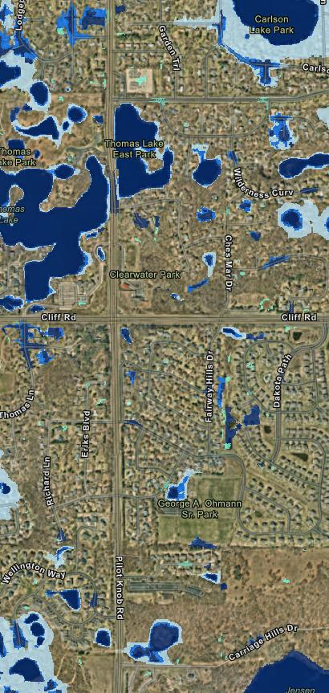
Regional growth management
Long-term effects of large volume water users
Potential to use regional wastewater capacity planned for a community, including that for planned household growth
Region will continue to grow, even with those localized constraints, but it will be elsewhere in the region
Growth absorption in response to the newly created “constraint” is not planned for other parts of the region
May require the Council to reconsider its allocation of regional forecasts and its capital plans for wastewater

Slide 18
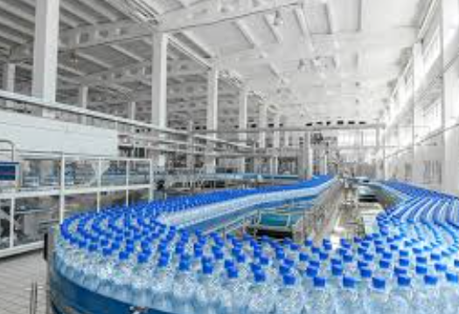
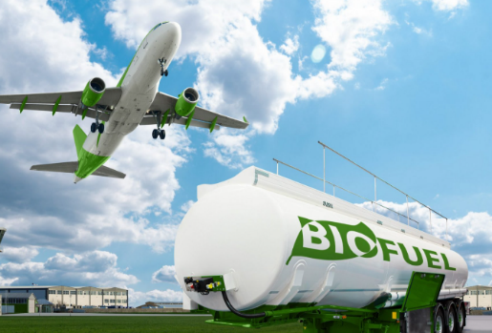

Conclusions
How to best advance regional goals
Council needs to be able to continue to provide regional service with the same (or better) levels of service while minimizing additional financial and environmental costs to the region and our communities.
Region can have industrial growth without necessarily sacrificing future needs, but we need the right information and the right time to make the best decision.
Local government staff need support to assess the trade-offs for their community.
What’s next:
ES finalizing projects to provide a greater understanding of environmental, water supply, and wastewater system impacts.
Potential discussions about developing new Met Council policy to address growth management needs.

