Slide 1
Large Quantity Appropriations – MDH Perspectives
Steve Robertson | Assistant Manager, Drinking Water Protection

Slide 2

Overview of Issues
New water appropriation directly from Public Water System
Water source separate from Public Water System
Land use considerations
Maintaining public trust

Slide 3

Adding new demand to Existing Public Water System
DNR Appropriations permit sufficient?
Existing PWS infrastructure sufficient?
Wells, treatment plant, distribution conveyances
New permits, other regulatory requirements
Plan time
Prepare financially

Slide 4
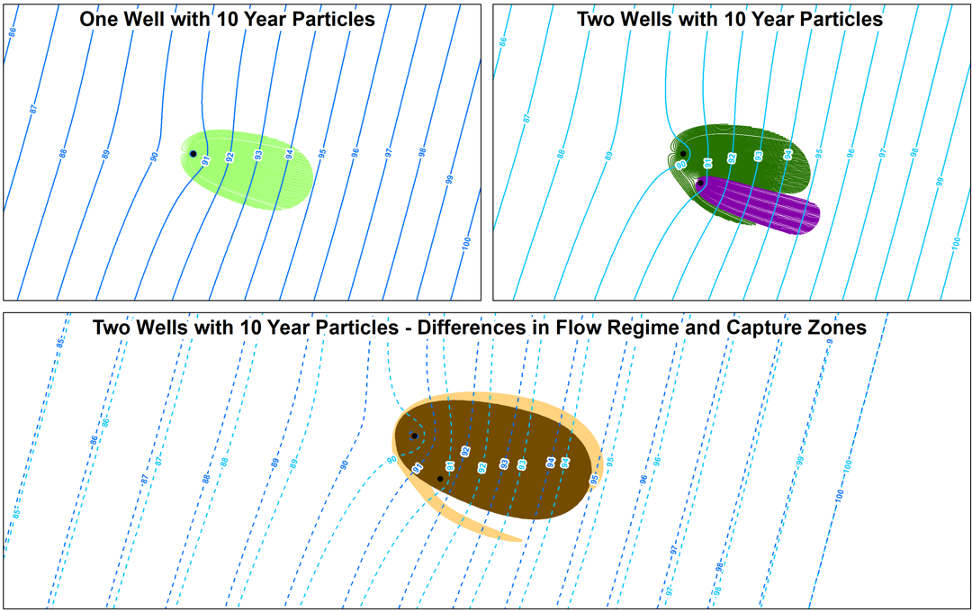
New water appropriation separate from public water system
Altered groundwater flow regime
Implications for Drinking Water Supply Management Area (DWSMA)
Nearby plumes of contamination
Effects on private wells

Slide 5

Land Use Considerations
Within DWSMA?
Vulnerability of DWSMA
Stormwater
Fuel storage
Other

Slide 6
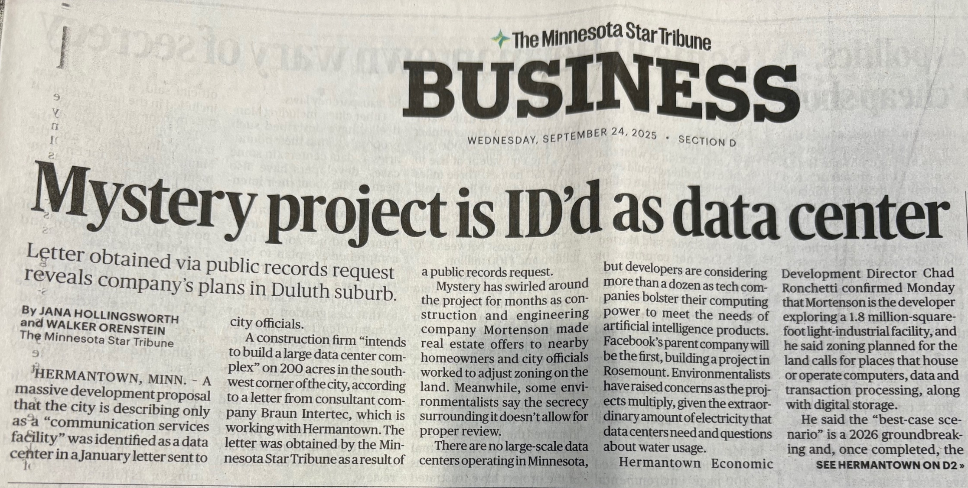
Public Trust
Lack of transparency can undermine public trust
If they hear from you first, they’ll trust you first
Proactive, transparent
If they hear from you last, they’ll trust you last
Reactive, secretive
Environmental review

Slide 7
Questions?
steve.robertson@state.mn.us

