Slide 1
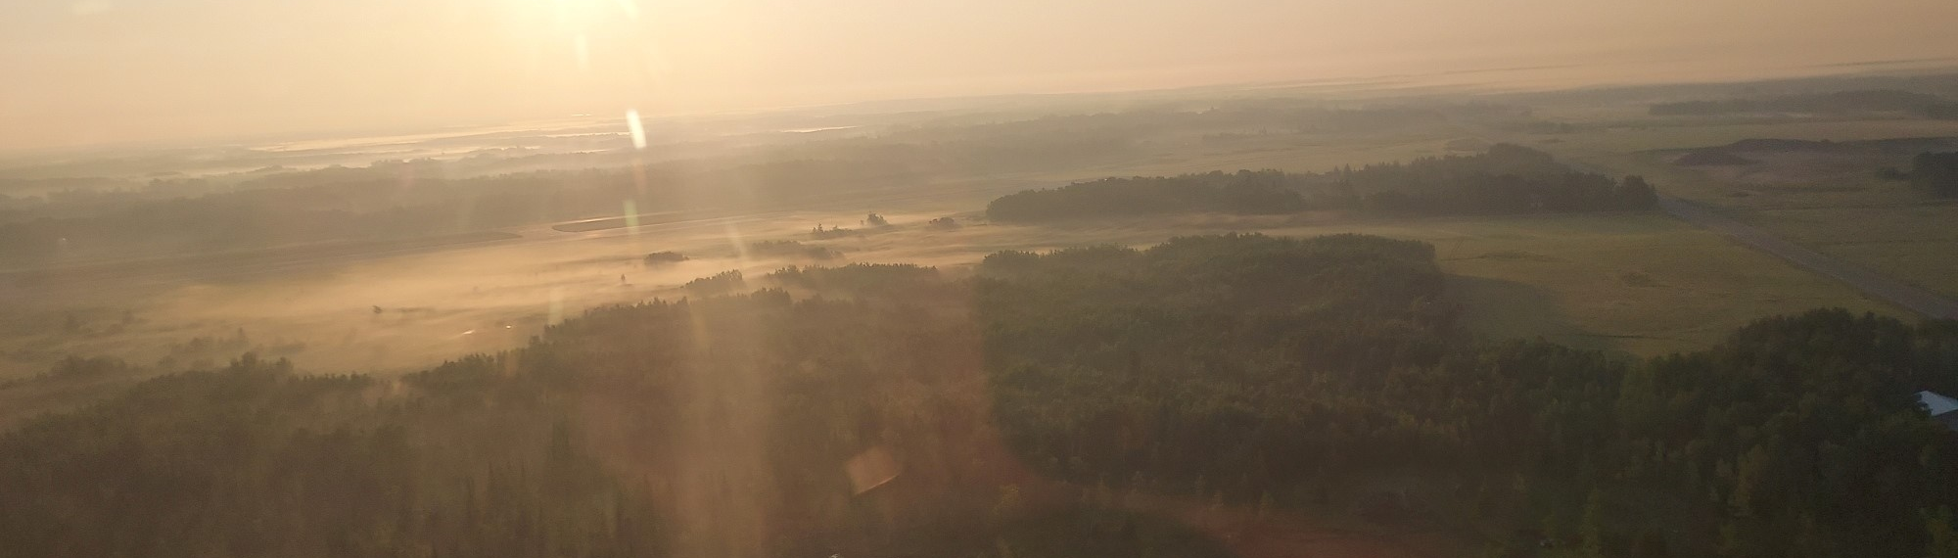

Meeting our Water Supply needs in the Land of 10,000 Lakes
Jason B. Moeckel | Assistant Division Director
Ecological and Water Resources Division
Groundwater | Minnesota DNR (state.mn.us)

Slide 2
The amount of water we can use is in fact limited!
Distribution – natural limits
Quality – both natural and contamination limits
Existing or future uses – competition limits
#1 - Domestic use
#2 - Small scale <10,000 gallons per day
#3 - Agriculture
#4 - Energy
#5 – Industry (includes data centers)
#6 - Non-essential
Notes:
We can all agree we don’t have an unlimited amount of water available where we need and when we need. So water is in fact limited.
The DNR has many regulatory responsibilities involving water, the primary responsibility we are talking about today involves the authorization to use large volumes of water, 10,000 gallons a day or 1 MGY. For context a family of four might use as little 30,000 gallons a year to more than 100,000. One benchmark is 75 GPCD.
As we think about what can limit our ability to use water, I like to think about these as natural limits (it’s physical there or it isn’t).
Quality is an important consideration natural levels of contaminants and introduced contaminants
Competition limits – other uses and users.
MN Statute says we have to “assure adequate supply to meet long-range seasonal requirements for domestic, municipal, industrial, agricultural, fish and wildlife, recreational, power, navigation, and quality control purposes”.
MN Statute also puts a priority on those uses, domestic use #1.

Slide 3
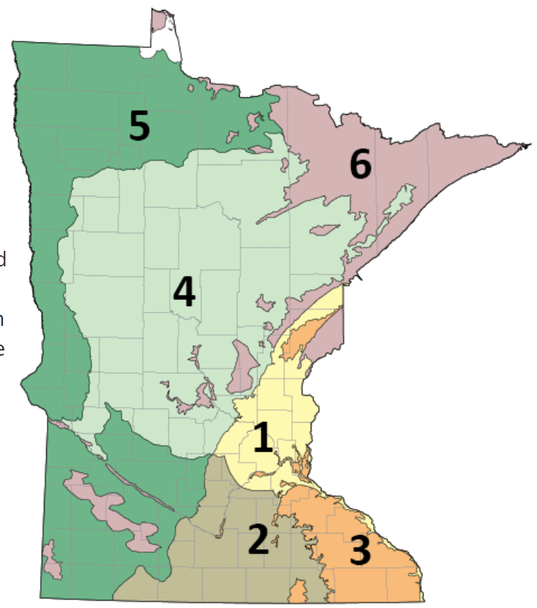
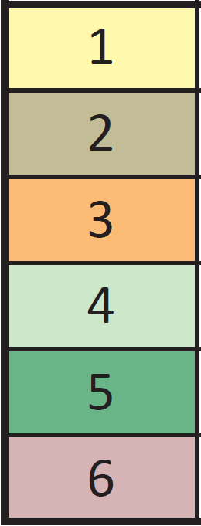
Tip #1:
Minnesota Groundwater Provinces
Location matters!
Pay attention to groundwater provinces.
Avoid clustered uses.
Some places are already pressing up against or exceeding limits.
Most Groundwater
Least Groundwater
Notes:
If you are working on groundwater supply in Minnesota, I have some tips for you. First: pay attention to groundwater provinces.
If you are working in the western province (Province 5), plan that it might take longer to get a permit.
If you are clustering groundwater wells together, that increases the likelihood for problems.

Slide 4
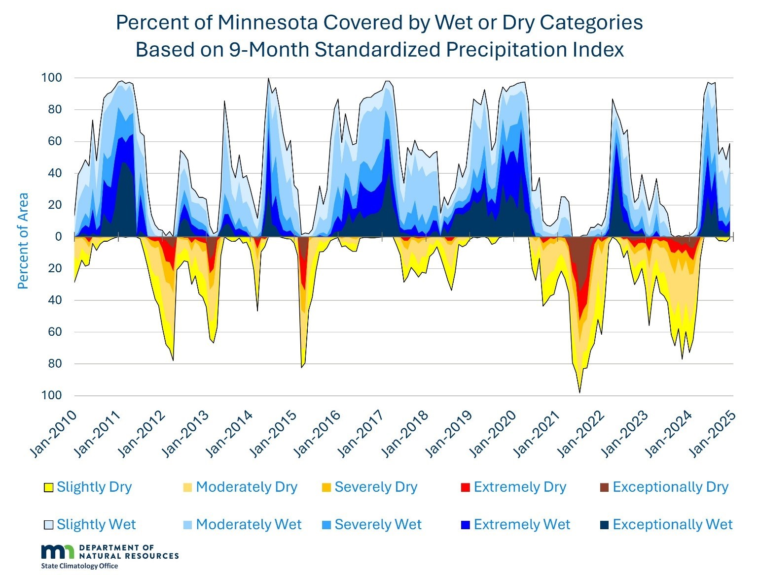
Climatic Drivers of Water Use
Notes:
Climate: Minnesota’s climate is changing outside of the range of normal variation. The trend towards more precipitation continues, even when accounting for recent dry years in the state.
Since the 2010s, Minnesota’s hydroclimate has become much more variable, with alternating extremes of wet and dry cycles (as shown in this figure). These wet and dry periods have varied in their timing, geographic extent, and magnitude. As a result, Minnesota has experienced multiple episodes of significant drought and significant flooding in a short time, at scales ranging from localized to statewide. Some areas have faced swings from the worst levels of drought on the US Drought Monitor, to historic or even unprecedented flooding in nine months or less (see pop-out message).
The Rainy River Basin - From May through August 2021, the area received just half of its normal precipitation and ended up with the worst drought conditions since 1980. The next nine months, September through May, however, were by far the wettest on record for that period, exceeding normal precipitation by 80%. Rainy Lake rose to its highest levels in 115 years of record, with historic flooding on the Rainy River and Lake of the Woods.
Climate projections for Minnesota show greater extremes of precipitation and also longer dry spells throughout the century.
Take Home Message: Planning for the future should account for even greater extremes of wetness and dryness than Minnesota has experienced recently.

Slide 5
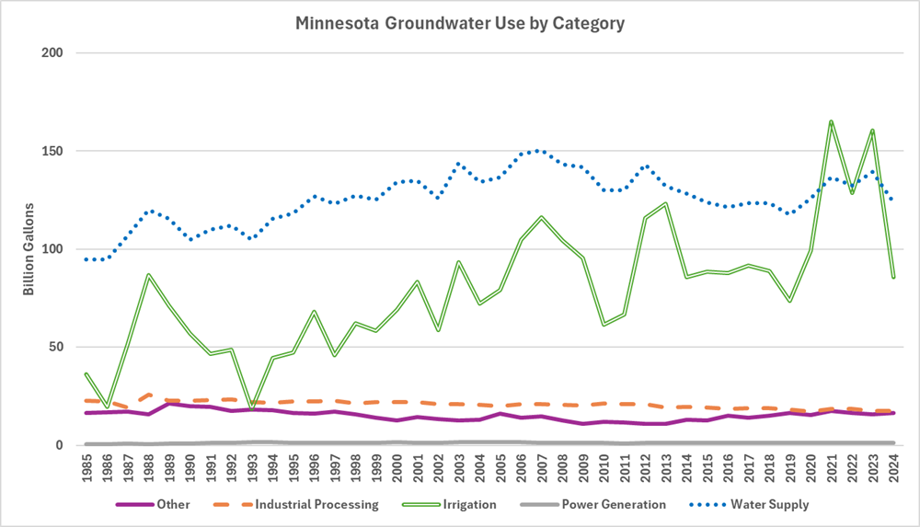
Groundwater Use Trends
Notes:
The total volume of water (surface and groundwater) used decreased over the last 20 years, most notably in the energy sector, due to the reduction of water use in power plants.
This graph is showing groundwater use by category. Statewide, groundwater use increased by one-third during in the drought years of 2021 to 2023, largely due to irrigation in during dry periods.

Slide 6
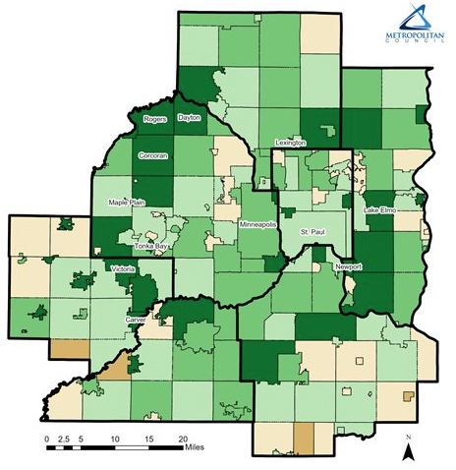
Tip #2:
Percent Change in Number of Households
-1%
0%
+1%
+2%
If you are working in the 7 – County metro:
Urban fringe has many domestic wells.
Groundwater is not unlimited.
Mpls.
St. Paul
Modified after: Metropolitan Council. (2024, July). Metro population growth slows, construction strong. Retrieved November 4, 2024, from https://metrocouncil.org/News-Events/Council-News/Newsletters/Metro-population-growth-2024.aspx
Notes:
Second: if you are working in the metro area, it is true that groundwater is more abundant than elsewhere in the state, but we will still need information on domestic wells.
If you are working on the urban fringe, there might be a lot of domestic wells.

Slide 7
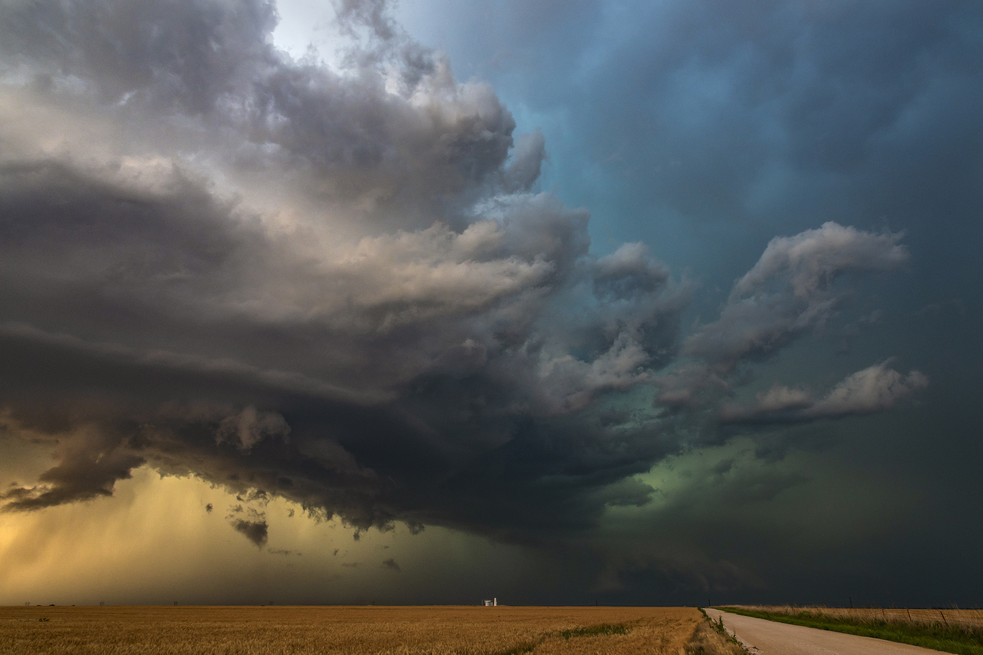
Tip #3:
Be clear about how much water is really needed:
Peak pumping rate
Time of year when peak pumping will occur
Annual volume
Notes:
Don’t assume there is lots of water so conservation measures aren’t needed.

Slide 8
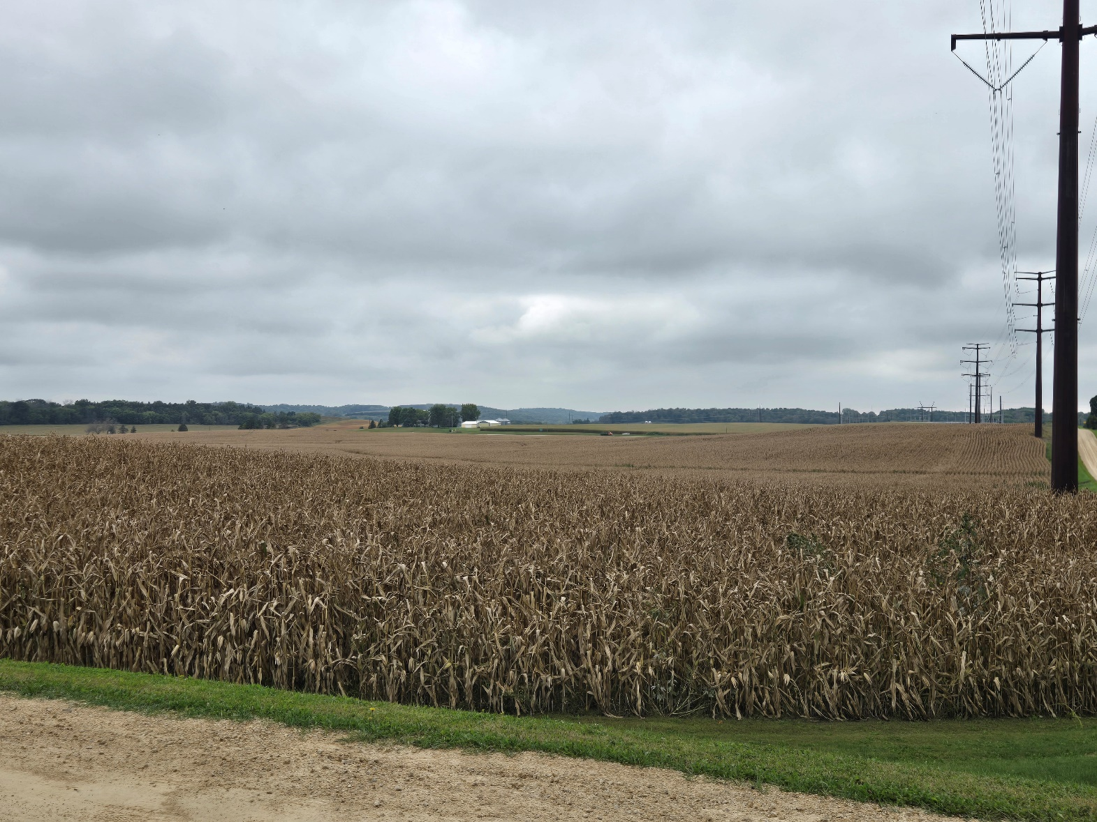
Data Center Early Coordination (103G.265 Subd 5)
Proposed large Data Centers coordinate with Minnesota Business First Stop
Allows DNR to request necessary information to assess site suitability and constraints for water use
All communication and information is considered non-public data until there is an application submitted
Does not exempt any testing or analysis required as part of a permit application/modification
Project Skyway Site, 9/23/2025 – Pine Island MN
Notes:
In June, the state legislature and the governor signed a data center bill that addressed water and power concerns. I’m going to focus on the water aspects that we are implementing at DNR as I do not know much about the power side. This legislation is only applicable to data centers, not all large water users. DNR and all agencies, are required to coordinate efforts with Minnesota Business First Stop. This statute allows DNR to request a large amount of information from proposers to ensure that the water source can produce sufficient volumes of water. However, we cannot require the information be submitted until we receive an application. The important item is that the legislation does not preclude DNR from requiring any additional information or testing as part of the permit application process. We are limited however in what we can do. This statute does not require any data center to engage in early coordination, but we are allowed to engage them as soon as we learn about a facility and ask questions. Look for more information on this soon! Lastly, up until we receive the preliminary well construction assessment, permit application, or permit amendment request for a data center site, all of the information is considered non-public data.

Slide 9
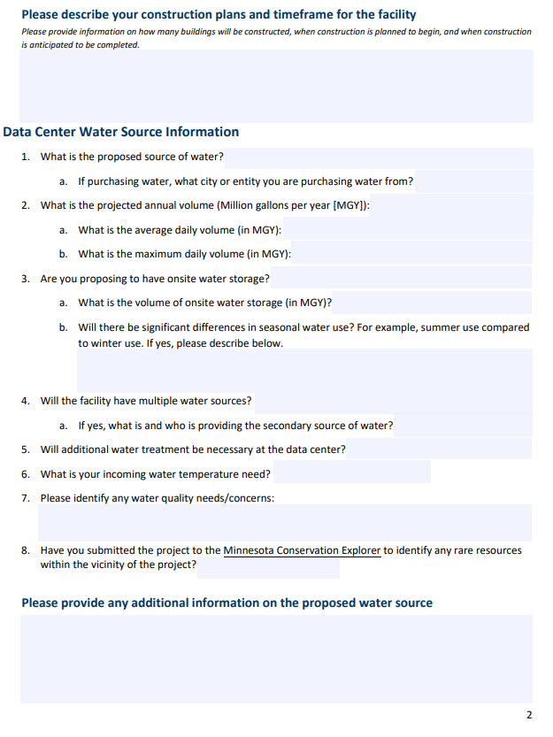
What are we looking for
Water use Info
Cooling System Technology
Municipal information
New Wells?
Coordination with Minnesota Department of Health
Rare resources
Notes:
This legislation gives us the opportunity to request data from these facilities so we can provide a robust high level assessment on if a proposal can be sustainable. Our goal is to at least get some basic water use information, including the water source, both how they are getting water and who is supplying it. We also want to know what the peak and average information is, so we can verify information. Since most water use in these areas are also irrigated areas, the peak use will be a significant consideration if these uses can be sustainable, especially as we build our knowledge. One of our biggest concerns is the cumulative impact of hot summer days over an extended period of time. Our goal is to work through this with these proposer, to ensure that the use is sustainable early in the process. We are also coordinating with our partners at the Minnesota Department of health. They manage and permit the public water suppliers in Minnesota. DNR manages the use, but health manages the rest, including quality and construction at public water supplies. They about wells and treatment and anything that may alter the source water protection area including migration of contamination.

Slide 10
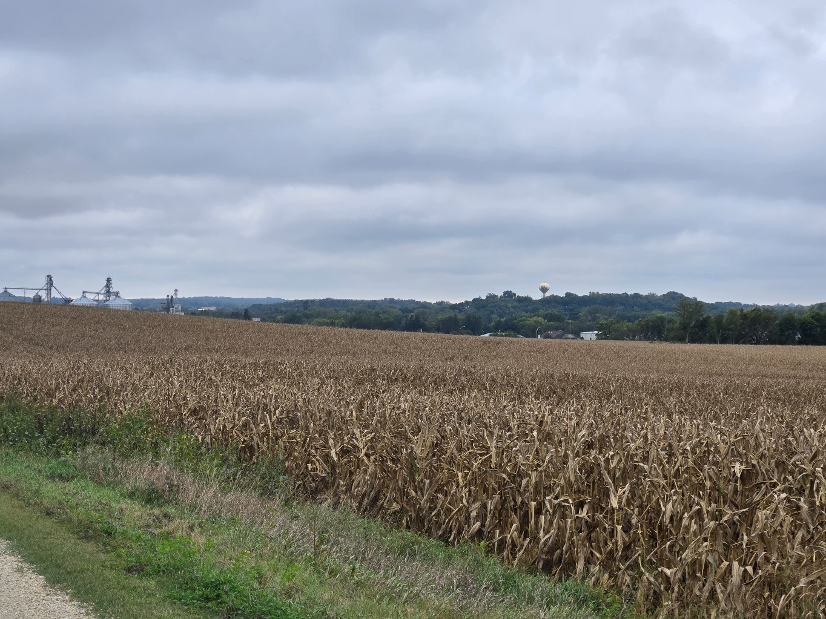
Permit Requirements (103G.271 Subd 5b)
Amend permit to add conservation requirements – if the Data Center will use more than 100 MGY
At the time a permit is issued, we must verify conservation measures that will be implemented
Cooling System efficiency (e.g. closed loop)
Water Reuse
Address water use conflict as part of the permit application/review process
Require an aquifer test if the commissioner determines one is necessary
Project Skyway Site, 9/23/2025 – Pine Island MN
Notes:
In addition to the early coordination pieces, DNR is required to include permit requirements for Data Centers that use more than 100 MGY. One, is to add conservation requirements that promote the most efficient use of water, water be reused, and that we support water replenishment efforts in the watershed. This allows DNR to encourage the most water efficient cooling system for the site, and ensure that DNR is adequately protecting the public health, safety and welfare from a water availability standpoint.

Slide 11
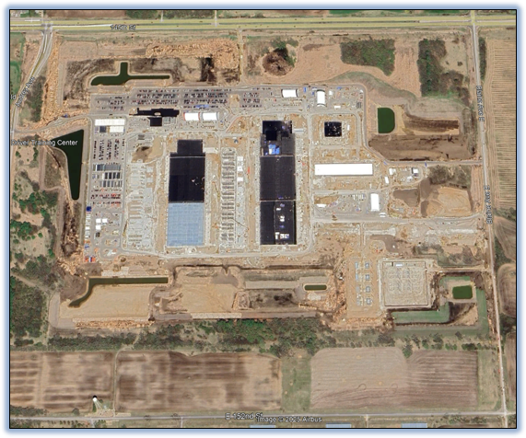
How is DNR Handling Proposals?
Response/Review Team
Coordinate the response team if the proposal is larger than 100 MGY
Requests additional Information from the proposer
Response team will prepare a summary of water availability constraints
This will be provided to the proposer
Currently evaluating how to assess water conservation requirements
Notes:
Since this legislation is new, we are currently developing an internal review process and fine tuning it using current proposals. As of right now, we have a quick response team to assess new large data center proposals. One of the keys is, any communication with data center proposals, is that if they are using more than 100 MGY, all communication and information shared is non-public until a permit application is received. We are working to identify steps and questions, to evaluate an initial water availability assessment that we can provide to proposers. However, if water use is less than 100 MGY, these protections are not provided. It does not preclude us from doing early coordination but could hinder it if a facility or utility chooses not to respond due to lack of protection.

Slide 12
Things to Consider
Large water appropriations may require additional environmental review
Water appropriations averaging 30 million gallons per month require a mandatory Environmental Assessment Worksheet.
*Projects that meet or exceed this threshold cannot be reviewed by the AUAR process*
While environmental review is required or ongoing, no permits can be issued
*This is referred to as the "Prohibition on Governmental Actions" (Minn. Rules 4410.3100)

Slide 13
Things to Consider
Are there opportunities to use water more than once?
Can water be used for agricultural irrigation after going through a data center?
Can water go through a data center and then be used in combination with other municipal supplies?
Can the heat be dissipated below ground in an aquifer with recirculating heat exchangers?
What prevents treated wastewater from being a source of cooling water?

